Slide 1
An Investigation into the Extent and Biological Impacts of Endocrine Disrupting Chemicals (EDCs) in a Highly Effluent-Dominated River in New England: Preliminary Results
Katrina Kipp, EPA New England Regional Laboratory
Jim Lazorchak, EPA ORD Cincinnati Laboratory
April 21, 2011

Slide 2
Overview
Study objectives and partners
Year 1 research
Preliminary results
Discussion
Year 2 plans
Next steps

Slide 3
Study Objectives
Characterize the extent of EDC contamination in the Assabet River
Characterize EDCs and other CECs* in the effluents from the four major WWTPs on the river
Evaluate the impacts of EDCs on fish (minnows) reproductive health (feminization of males) in the river
Provide data that informs NPDES permit decisions regarding the need for reductions of inputs of EDCs
* CECs = Contaminants of Emerging Concern

Slide 4
Study Design
EPA Region 1 and Cincinnati ORD Lab:
Effluent sample collection from 4 WWTPs (Westborough, Marlborough West, Hudson, Maynard)
Chemical analysis for Pharmaceuticals, steroid suite, NPs, & PFCs (based on National Effluent Study protocols)
48 hours larval effluent exposure tests
Fish collection at Assabet River National Wildlife Refuge (study site) and A-1 Reservoir (study control) for analysis of fish for feminization indicators

Slide 5
Partners Activities
USFWS: national study of bass at Refuges
USGS: analysis of river water for EDCs
OAR and UMA: larval effluent exposure tests and public awareness effort

Slide 6
EPA Work Completed to Date
Effluent samples collected at 4 WWTPs
Effluents sent to EPA Cincinnati Lab for chemical analysis (54 PPCPs, 8 steroids, 19NPs, BisPhenol A, 14 PFCs)
Laboratory 48 hours larval fish effluent exposure test conducted
Fish collection completed at control (A1 Reservoir) and Refuge sites
EPA: golden shiners
USFWS: largemouth bass
Fish dissected and shipped to Cincinnati lab
Liver analyzed for vitellogenin induction
Gonads analyzed for gender ID & histopathological changes

Slide 7
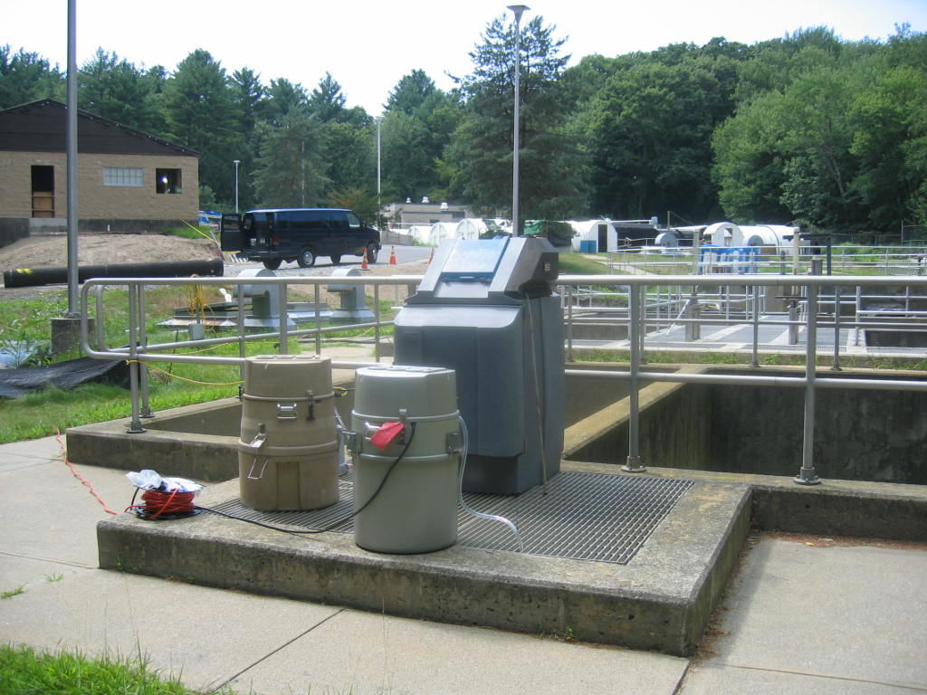
Effluent Samplers

Slide 8
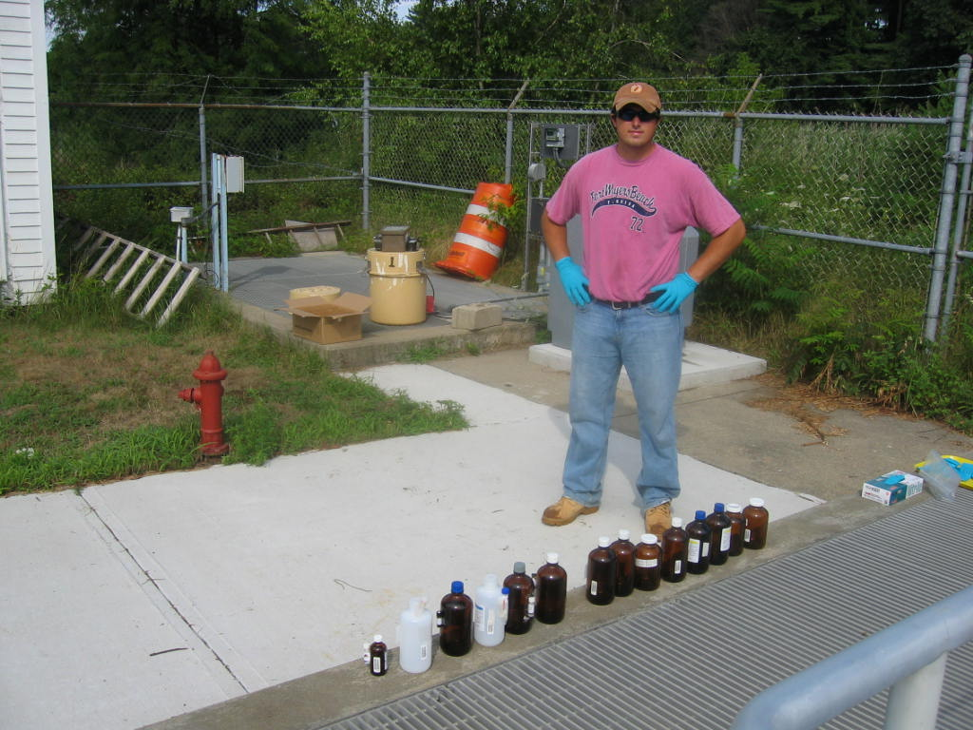
Samples from WWTPs

Slide 9
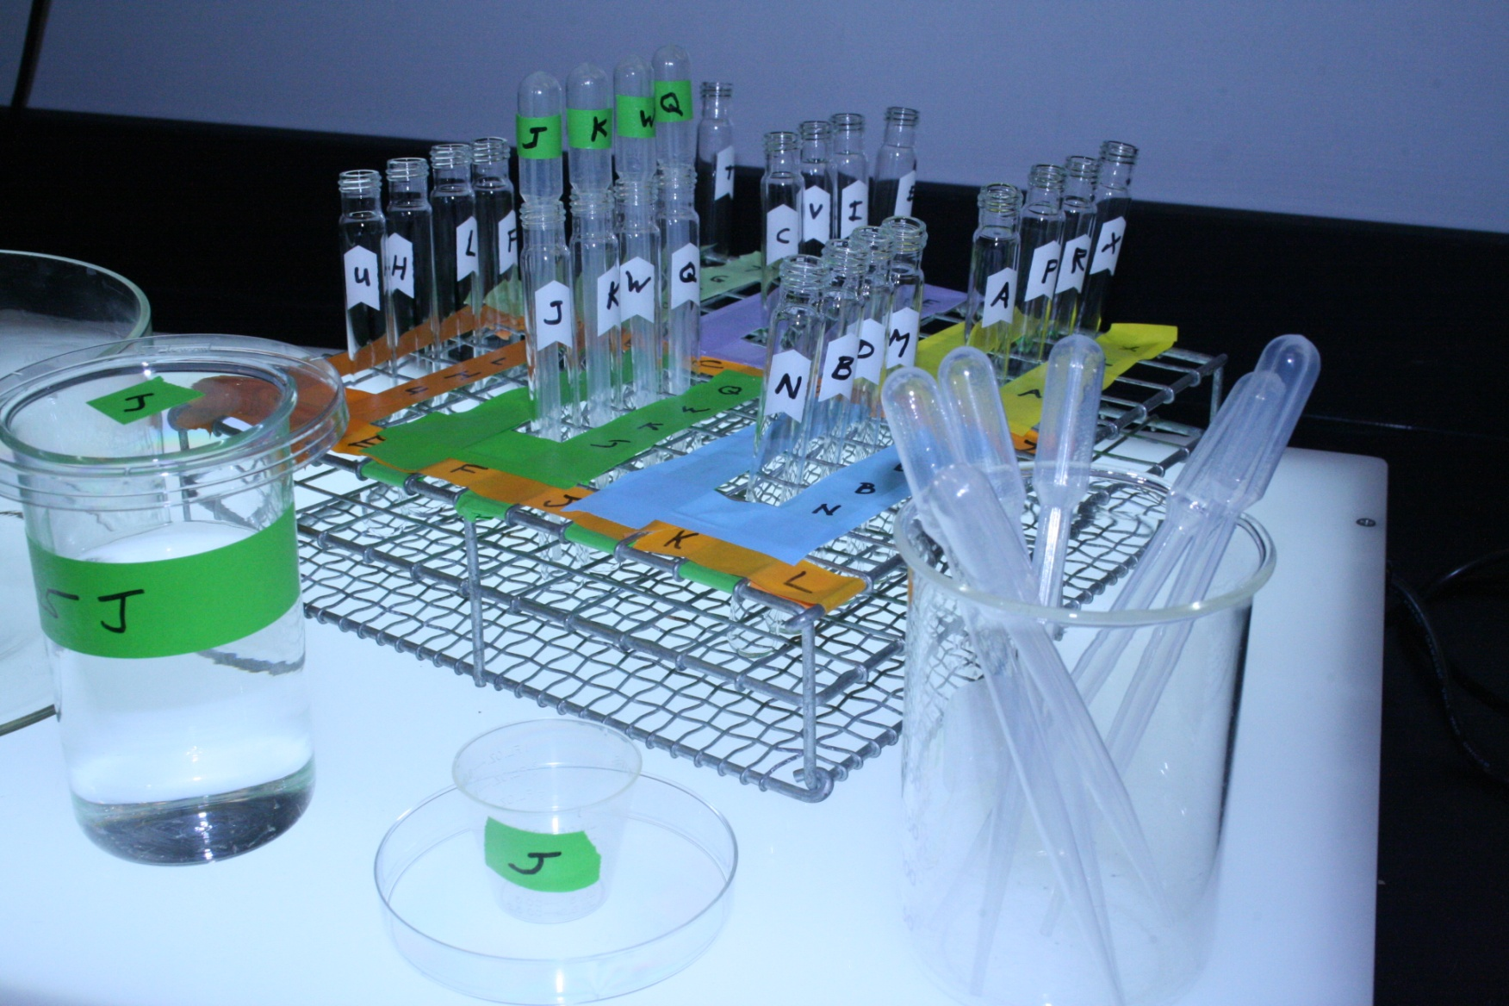
Larval Exposure Test Set-Up

Slide 10
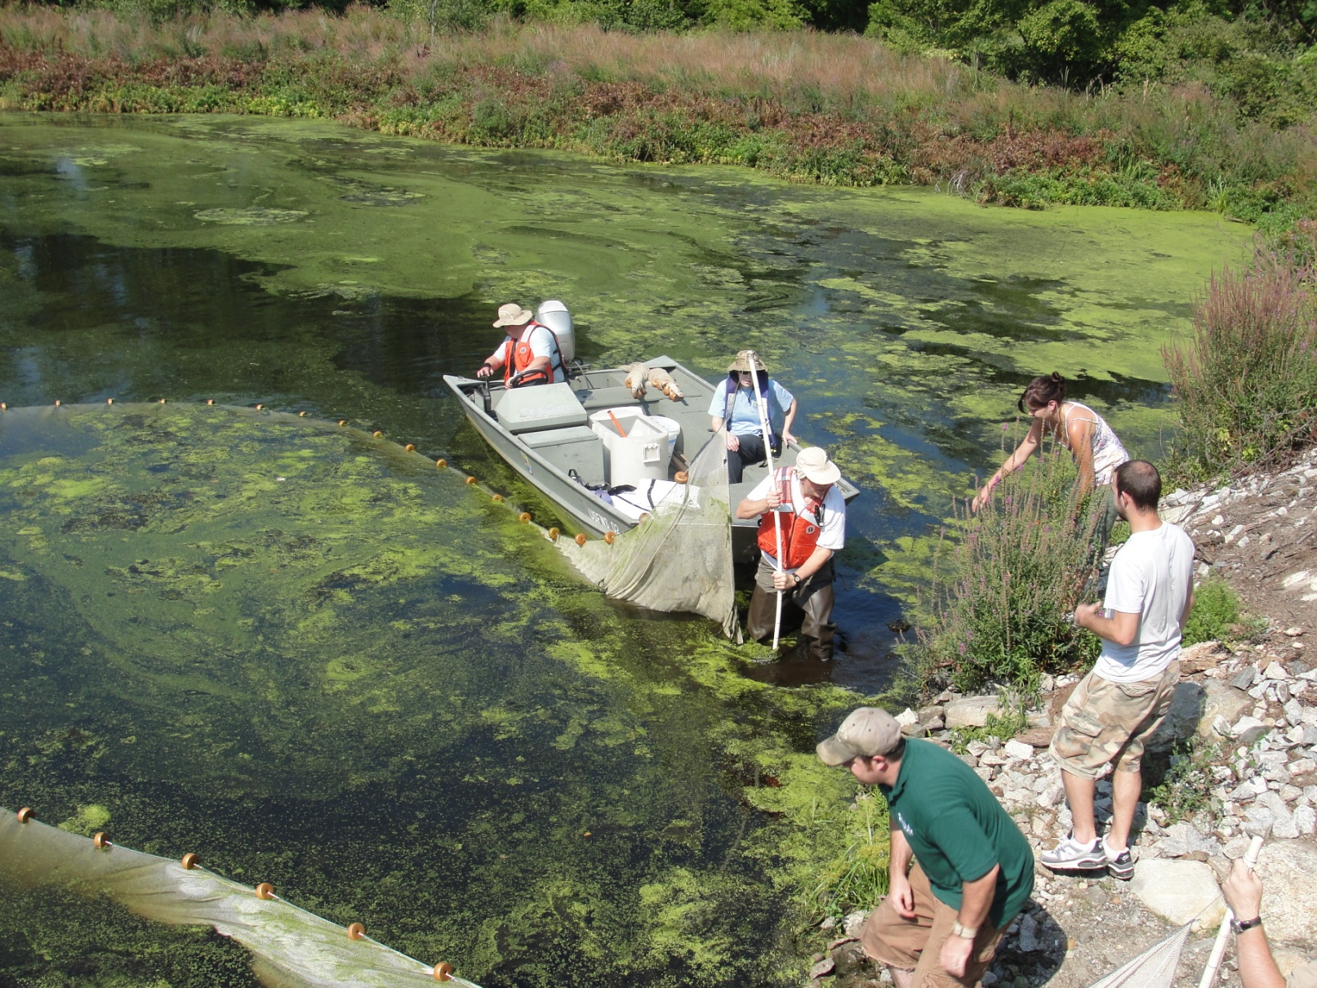
Seining at the Refuge

Slide 11
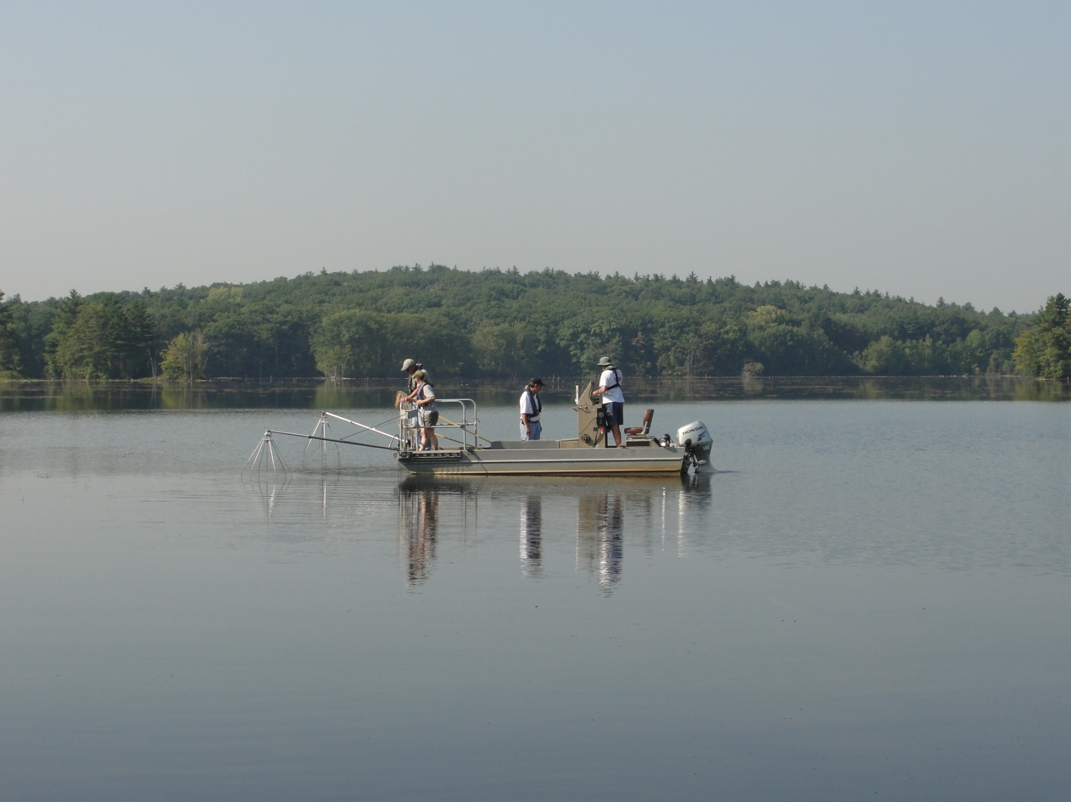
Electrofishing at A-1 Reservoir

Slide 12
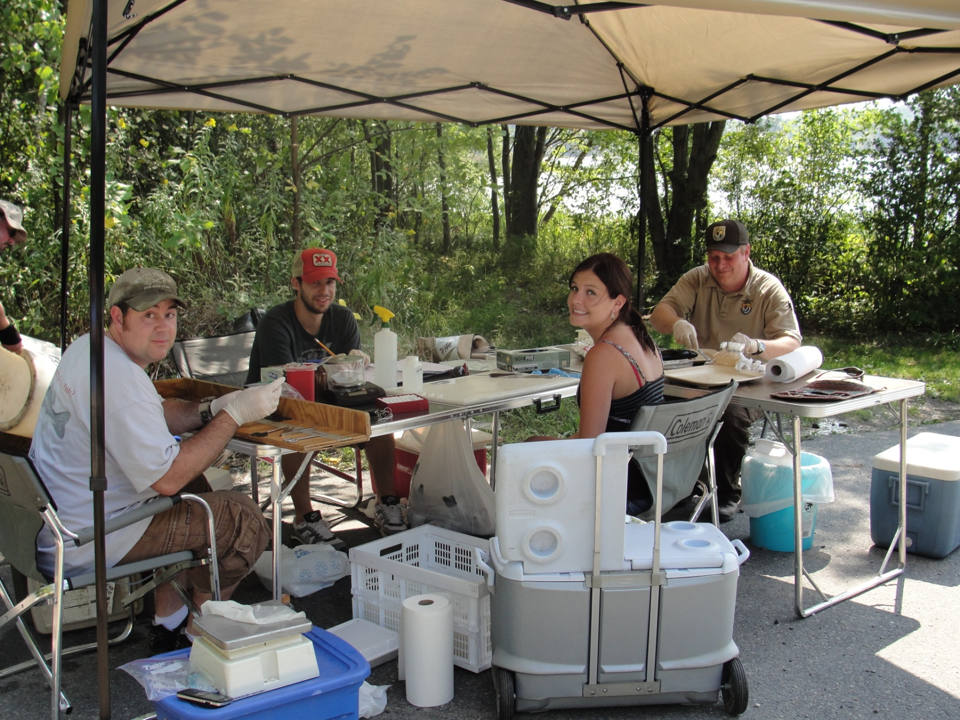
Fish Dissection

Slide 13
Pharmaceuticals Found In WWTP
Compound | ARP1 | ARP2 | ARP3 | ARP4 | Broad MOA Class
Cimetidine | nd | 22 | nd | 13 | h2 anti-histamine
Ranitidine | nd | 149 | nd | 120 | h2 anti-histamine
Trimethoprim | 93 | 183 | 18 | 175 | Antimicrobial
Sulfamethoxazole | nd | 1096 | 316 | 667 | Antimicrobial
Norethindrone | nd | nd | nd | nd | Reproductive hormone modulator
Atorvastatin | nd | 21 | nd | 63 | Lipid modifier
Gemfibrozil | nd | 1030 | 20 | 1066 | Lipid modifier
Theophylline | nd | nd | nd | 19 | Bronchodilator
Ibuprofen-2-hydroxy | nd | nd | nd | 164 | Inactive Metabolite
Acetaminophen | nd | nd | nd | 129 | Anti-inflammatory
Ibuprofen | nd | 104 | nd | 586 | Anti-inflammatory
all concentrations are in ng/L
nd = not detected above the reporting limit
Values @ 1 ug/L
Trimethoprim detected in the field blank
1- Westboro
2-Marlboro
3-Hudson
4-Maynard

Slide 14
Pharmaceuticals Found In WWTP
Compound | ARP1 | ARP2 | ARP3 | ARP4 | Broad MOA Class
Triamterene | 32 | 27 | 132 | 180 | Anti-hypertensive
Desmethyl-diltiazem | 17 | 49 | 37 | 96 | Anti-hypertensive
Diltiazem | 60 | 175 | 39 | 297 | Anti-hypertensive
Norverapamil | nd | nd | nd | 18 | Anti-hypertensive
Verapamil | 51 | 25 | 9 | 61 | Anti-hypertensive
Valsartan | nd | 282 | 189 | 1337 | Anti-hypertensive
Furosemide | nd | 329 | 55 | 452 | Anti-hypertensive
all concentrations are in ng/L
nd = not detected above the reporting limit
Values @ 1 µg/L

Slide 15
Pharmaceuticals Found In WWTP
Compound | ARP1 | ARP2 | ARP3 | ARP4 | Broad MOA Class
Metoprolol | 727 | 505 | 553 | 612 | Neurotransmitter modulator
Propranolol | nd | 32 | 12 | 46 | Neurotransmitter modulator
Carbamazepine | 106 | 144 | 294 | 196 | Neurotransmitter modulator
10-hydroxy-amitriptyline | nd | 2 | nd | 4 | Neurotransmitter modulator
Amitriptyline | nd | 1 | nd | nd | Neurotransmitter modulator
Fluoxetine | nd | 28 | 16 | 46 | Neurotransmitter modulator
Sertraline | nd | 25 | nd | nd | Neurotransmitter modulator
Albuterol | nd | 8 | nd | 20 | Neurotransmitter modulator
Atenolol | 383 | 571 | 306 | 1663 | Neurotransmitter modulator
Oxycodone | 98 | 75 | 33 | 181 | Neurotransmitter modulator
Amphetamine | nd | nd | nd | 5 | Neurotransmitter modulator
Hydrocodone | 31 | nd | nd | nd | Neurotransmitter modulator
all concentrations are in ng/L
nd = not detected above the reporting limit
Values @ 1 µg/L

Slide 16
Hormones and Phenolic
Compounds in WWTPs
WWTP | E1 |  | E2 |  | EE2 |  | E3 |  | DHT |  | AND |  | TEST |  | PROG | Total NP
 | ng/L |  | ng/L |  | ng/L |  | ng/L |  | ng/L |  | ng/L |  | ng/L |  | ng/L | ug/L
ARP1 | < MRL |  | < MRL |  | < MRL |  | < MRL |  | < MRL |  | < MRL |  | 4.56 |  | < MRL | 5.5
ARP2 | 8.83 | S | < MRL | S | < MRL | S | < MRL | S | < MRL |  | 1.58 |  | < MRL |  | < MRL | 5.7
ARP3 | < MRL | S | < MRL | S | < MRL | S | < MRL | S | < MRL |  | < MRL |  | 20.3 |  | < MRL | 5.2
ARP4 | 21.4 |  | 2.34 |  | 2.68 |  | 5.50 |  | < MRL |  | 3.70 |  | < MRL |  | < MRL | 5.9
D: duplicate differs in greater than 50% R: fortified recovery is out of criteria (75%–125%) S: fortified recovery is out of criteria (75%–125%)
MRL = ~1 ng/L
Concentrations of EE2 > 1 ng/L have been shown to cause reduced fecundity EPA AQC for NP = 6.6 ug/L 4-day aver once/3 years

Slide 17
Fluorinated Chemicals in WWTP
WWTP | C3 |  | C4 |  | C5 |  | C6 |  | C7 |  | C8 PFOA |  | C9 |  | C10 |  | C11 |  | C12 |  | C13 |  | PFBS |  | PFHS |  | PFOS
 | ng/L |  | ng/L |  | ng/L |  | ng/L |  | ng/L |  | ng/L |  | ng/L |  | ng/L |  | ng/L |  | ng/L |  | ng/L |  | ng/L |  | ng/L |  | ng/L
ARP1 | 4.14 | ^{D, R} | 2.12 |  | 4.71 | ^{R} | 2.56 | ^{D,R} | 1.63 | ^{D,R} | 75.0 | ^{D,R} | 1.00 |  | 0.972 | ^{D,R} | < 0.5 |  | < 0.5 |  | < 0.5 |  | 1.96 |  | 3.77 |  | 10.9
ARP2 | 23.3 |  | 1.63 |  | 3.03 | ^{R} | 3.77 | ^{R} | 1.11 | ^{R} | 11.6 | ^{R} | < 0.5 |  | < 0.5 |  | < 0.5 |  | < 0.5 |  | < 0.5 |  | 3.58 |  | 2.87 |  | 60.6 | ^{R}
ARP3 | 113 | ^{R} | 56.6 | ^{R} | 33.4 |  | 28.4 | ^{R} | 14.3 | ^{R} | 9.37 | ^{R} | 1.24 |  | < 0.5 |  | < 0.5 |  | 0.755 | ^{R} | < 0.5 |  | 196 |  | 2.42 |  | 4.04 | ^{R}
ARP4 | 135 | ^{D, R} | 1.20 |  | 1.48 | ^{R} | 4.97 | ^{D,R} | 0.585 | ^{D} | 1.56 | ^{D,R} | < 0.5 |  | < 0.5 |  | < 0.5 |  | < 0.5 |  | < 0.5 |  | 1.76 | ^{D,R} | 15.9 | R | 6.51
C8 = PFOA
Mn Pollution Control Agency Aquatic Life Criteria:
PFOS Chronic = 7 ng/L (perfluorooctane sulfonate)
PFOA Chronic = 720 ng/L (DW and Non-salmonids)
Qualifier: D: duplicate differs in greater than 50%
R: fortified recovery is out of criteria (75%–125%)

Slide 18
Summary – Effluent Chemistry
Pharmaceuticals
35 out of 54 detected
1 - Inactive Anti-inflammatory Metabolite
1 - Reproductive Hormone Modulator
1 – Bronchodilator
2 - Lipid Modifier
2 - h2-anti-histamine
2 – Anti-microbials
2 - Anti-inflammatory
12 - Neurotransmitter Modulator
6 detected near or above FDA Categorical Exclusion Value of 1 µg/L
Not in every plant; across all 4

Slide 19
Summary – Effluent Chemistry
Hormones
1 Plant has measured EE2 concentration above concentration causing effects on fecundity
PFCs
2 Plants had PFOS/PFOA levels near MPCA Aquatic Life Criteria

Slide 20
Golden Shiner Histology Results 30 collected at each of two sites (Only fish assessed for Vtg expression)
Fish # | Site Location | Sex | Gonad Stage (0=immature; 5=spawned out) | Notes
 | Reservoir |  |  | 13- immature males (Mean Gonad Stage = 0) 10 - immature females 2 - mature Females (Mean Gonad Stage 0.97)
A27 | WBR | Female | 2
A28 | WBR | Female | 2
A29 | WBR | Immature Male | 0
B1 | Assabet River Below WWTP (ARB) | Male | 3 | 15 - immature Males (Mean Gonad Stage = 0.2) 7 Females - 4 immature Females (Mean Gonad Stage = 1.6)
B6 | ARB | Female | 2
B7 | ARB | Immature Male | 0
B8 | ARB | Immature Male | 0
B9 | ARB | Immature Male | 0
B13 | ARB | Female | 2
B16 | ARB | Female | 2
B17 | ARB | Female | 2
B21 | ARB | Female | 2
B24 | ARB | Female | 2
B26 | ARB | Female | 2
B29 | ARB | Insufficient tissue provided

Slide 21
Golden Shiner Data
Golden Shiners were too immature to obtain gene expression results
No Larval Vtg Gene Expression results due to method still under development – Expected to be done in May

Slide 22
Collaborating Scientists
Pharmaceuticals – Angela Batt (ORD), batt.angela@epa.gov
Pharmaceutical Prioritization and Assessment - Mitch Kostich (ORD), kostich.mitchell@epa.gov
Hormones – Marc Mills (ORD), mills.marc@epa.gov
Phenolic Compounds (Region 5) – Larry Zintek, zintek.lawrence@epa.gov
Perfluronated Compounds (former EPA post doc) – Shoji Nakayama fabre@nies.go.jp
Larval Fathead Minnow Vtg Gene Expression Method – TV Reddy (ORD), reddy.timuru@epa.gov, David Lattier (ORD), lattier.david@epa.gov, Denise Gordon (ORD), gordon.denise@epa.gov
Effluent Exposures – Mark Smith, Herman Haring, TMG c/o U.S. EPA
Field Collections – Herman Haring
Golden Shiner Vtg Analyses – Barry Wiechman, Dynmac Corp c/o U.S. EPA
Histopathology on Golden Shiners – Heiko Schoenfuss, St. Cloud State Univ. hschoenfuss@stcloudstate.edu

Slide 23
Proposed Year 2 Research
Resample 4 WWTP effluents
Chemical analysis for PPCPs, steroid suite, NPs, PFCs
Laboratory 48 hours larval effluent exposure tests
Deploy caged adult male fathead minnows and golden shiners for 7 days
Reference site and upstream and downstream of 4 WWTP outfalls
Vitellogenin induction

Slide 24
Proposed Year 2 Research
Under consideration:
Sampling river water for EDCs
Deploying SPMDs (semipermeable membrane device) in river for EDCs (VOCs)
Flow through systems located at WWTPs for effluent exposure
Repeat collection of indigenous minnows (golden shiners)
Vitellogenin
Histopathology

Slide 25
Future Work/Next Steps
Presentation at PPCP Forum on April 29
Communicate Year 1 results to WWTPs
Year 2 activities
Finalize plans
Amend QAPP
Conduct sampling/lab analysis
Presentation at SETAC meeting in Nov. (in Boston)
Final report in spring of 2012

Slide 26
Project Research Partners
EPA NE – Katrina Kipp, Tom Faber, Bart Hoskins, Dave McDonald
EPA ORD Cincinnati Lab – Jim Lazorchak, Marc Mills, Angela Batt, Larry Zintek (R5), Shoji Nakayama (Former EPA Post Doc), Herman Haring, Marks Smith, Barry Weichman, Mitch Kostich, David Lattier, TV Reddy, Denise Gordon, Heiko Schoenfuss (St. Cloud State U)
USFWS – Drew Major, Ken Munney, Libby Herland
USGS – Marc Zimmerman, John Colman
OAR – Sue Flint
UMass Amherst – Kathleen Arcaro, Kasie Auger

Slide 27
Questions?
For more information:
Katrina Kipp
EPA New England Regional Laboratory
617-918-8309
kipp.katrina@epa.gov
Jim Lazorchak
EPA ORD Cincinnati Laboratory
513-569-7076
lazorchak.jim@epa.gov

